Slide 1
CAPSTONE PROJECT ECOMMERCE -ELECKART
Submitted By:
Aravind Girish
Divya Saurabh
Thera Bhuvana Chandra

Slide 2
Problem Statement
As a data scientist or an analyst working for ElecKart, we need to develop a market mix model based on the given information and we need to observe the actual impact of different marketing variables over the last year and recommend the optimal budget allocation for different marketing levers for the next year.

Slide 3
BUSINESS OBJECTIVE
We are required to create market mix models for three different product sub-categories:
a)camera accessory b) home audio c) gaming accessories
To ensure that the budget is used effectively, we must monitor the actual effects of various marketing variables for the year (2015–2016) and make recommendations for the best budget allocation for the various marketing levers for the next year.
The steps we are taking to accomplish this goal are listed below:
1.Business Understanding and Data Cleaning 2.Exploratory Data Analysis 3.Feature Engineering
4.Model Building 5.Deriving insights based on the results
6.Recommendations to the business
CAPSTONE PROJECT ECOMMERCE -ELECKART

Slide 4
A SUMMARY OF BUSINESS UNDERSTANDING
We are given consumer data, which includes information about each purchase made within the designated time period as well as user-specific information like the user's zip code and order ID.
Information on media investments that offers us a good indication of how much money has been spent on each channel, such as TV, radio, etc.
Climate data in the Ontario region for the years 2015 and 2016
Data from the NPS score that provides us with a sense of customer happiness, which in turn affects stock market price.
Also, we are provided with a list of the local holidays, and we are informed that the first and fifteenth of each month are pay dates.

Slide 5
DATA CLEANING STEPS
The sole purpose of data understanding and data cleaning is to deal with inconsistencies in the dataset such as missing values, exponential values present in certain fields etc. We also convert the various datatypes to a common datatype which will help us in analysis.
We convert the relevant fields to the datetime datatype.
Since they are of least importance, columns like deliverybdays and deliverycdays that have more than 80% missing values will be removed.
On the dataset, we perform some initial analysis and calculations.
We substitute suitable values for all the missing variables in the various datasets.
Use gmv/units to impute the incorrect mrp values.
removing columns such as pincode, cust_id, and fsn_id because they don't add anything to the analysis.
Elimination of Duplicates in the Data Frame and the Column order_item_id.
Filtering the data for the 3 categories with Camera Accessory, Gaming Accessory, Home Audio.
Generate Week Column

Slide 6
KPIs AND EXPECTED RESULTS
Gross Merchandise Value (GMV), commonly known as revenue, is the target variable (an independent variable), and we must identify the characteristics that would lead to an increase in revenue.
The dependent variables are those that will directly affect the GMV, such as the amount and percentage of discounts offered on a product, the NPS rating, etc.
According to our codes, the NPS score, holidays, and paydates (the first and fifteenth of each month) all have a beneficial impact on sales.
We must determine which of the three subcategories—gaming, audio, and camera—the company needs to spend in to increase its revenue in the coming financial year.

Slide 7
FEATURE ENGINEERING
Feature engineering is the process by which we create new features from the data already present in order to increase relevance and raise the standard of data analysis. We do the following feature engineering tasks in this study:
Make a Week Column.
Updating the year for the week 53 to 2015, despite it being 2016 according to the other data sets.
Dropping Columns with Single Value or all Different Values
Creation of an additional feature GMV divided by units to get the list price.
Creating Payday column, If it is nearer to the salary day(1st and 15th of every month), we flag the column value as 1, else as 0
Creating holiday_flag if there is holiday or occassion in Ontario, we're flagging the line as 1 else 0
Creating a new column Product Type, If GMV value > 80 % then considering it as Premium_product, else mass_market

Slide 8
FEATURE ENGINEERING
Creating dummy variables for order_payment_typeFiltering data from July 2015 to June 2016.
calculating the marketing spend by calculating GMV%.
Reading product list using the file “Media data and other information”
Creating special sales with a value of 0 for Nulls and a value of 1 for event dates.
Mapping months to a month's number of weeks and getting a count of 52 weeks
Calculate 8-weeks Exponential Moving Average for all Advertising media channels.
Calculate 5-weeks and 3-weeks Simple Moving Average for advertising media channels, NPS and Stock_Index.
Creating (Net Promoter score)NPS - works as a proxy to ‘voice of the customer’ and Stock Index.

Slide 9
Steps & Visualization

Slide 10
DATA UNDERSTANDING -I July 2015 to June 2016
 | Description
FSN ID | The unique identification of each SKU
Order Date | Date on which the order was placed
Order ID | The unique identification number of each order
Order item ID | Different products under the same order generates different order Item IDs
GMV | Gross Merchandise Value or Revenue
Units | Number of units of the specific product sold
Order payment type | How the order was paid
SLA | Number of days it typically takes to deliver the product
Cust id | Unique identification of a customer
Product MRP | Maximum retail price of the product
Product procurement SLA | Time typically taken to procure the product
Additional Information
Monthly spend on various advertising channels
Days when there was any special sale on products
Monthly NPS score (this may work as a proxy to the ‘voice of the customer’)
Stock index of the company on a monthly basis
Climatic information of Ontario during 2015 and 2016

Slide 11
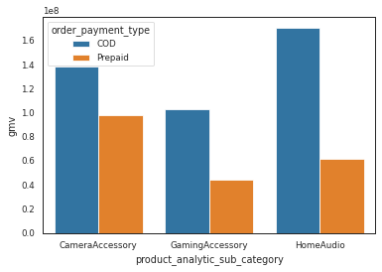
EXPLORATORY DATA ANALYSIS
GMV is our target variable
Home Audio generates the most money from COD orders, followed by Camera Accessories and Gaming Accessories.
Camera accessories generate the most money from prepaid orders, followed by home audio and a marginal decline in the area of gaming accessories.
11

Slide 12
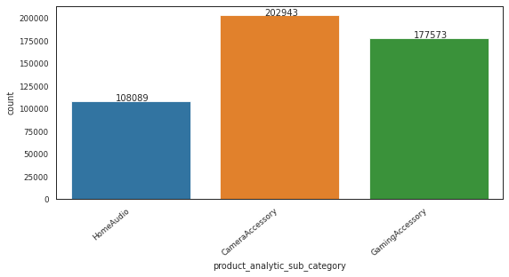
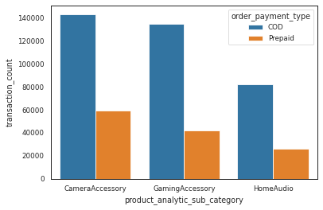
EXPLORATORY DATA ANALYSIS
No of transactions by Sub-Category
According to our analysis, the category with the most transactions was camera accessories, then gaming accessories, then home audio.

Slide 13
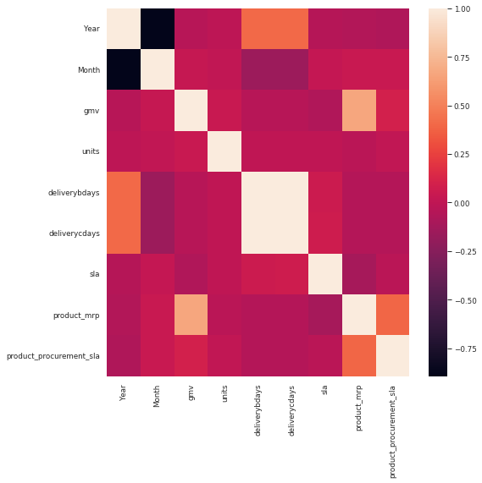
EXPLORATORY DATA ANALYSIS
Checking the correlations
CORRELATION MATRIX : Checking the correlation
Between the variables in the data set
Here we can observe that Month & Year are highly correlated.

Slide 14
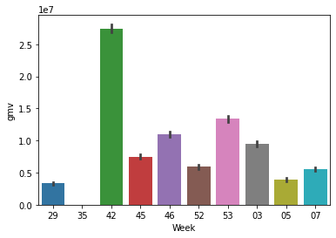
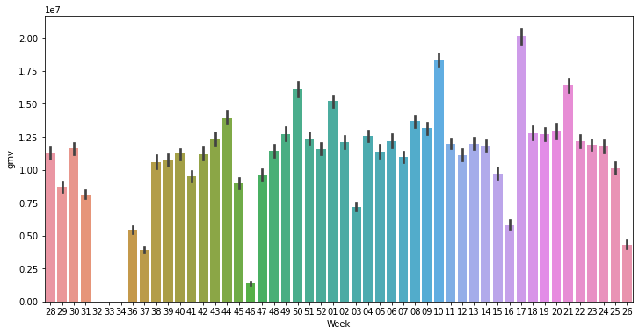
EXPLORATORY DATA ANALYSIS
Plot for special sales flag =1 (Special Sale)
Insights: The special sale day's week 42 biggest sales were noted.
Plot for special sales flag =0 (No Special Sale)
Insights: The week 17 special sales flag had the highest observed sales of 0.

Slide 15
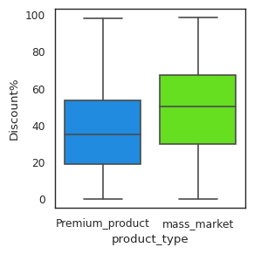
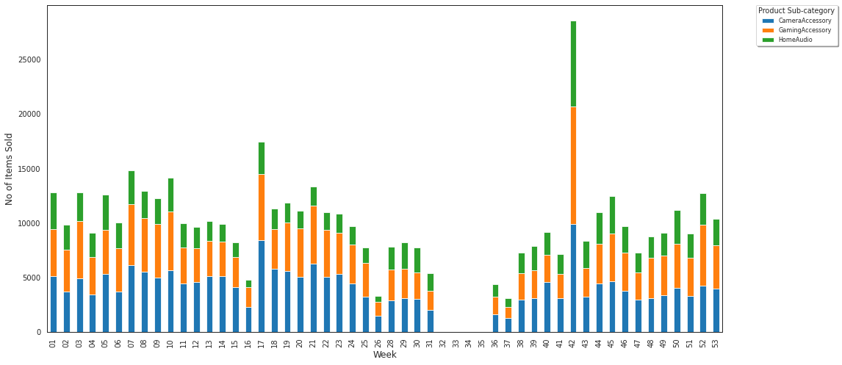
EXPLORATORY DATA ANALYSIS
The sale on the 42nd week (`Thanksgiving week`) is maximum. Overall, October has seen most no of items being sold.
Comparing Distribution of Discount% for product types

Slide 16
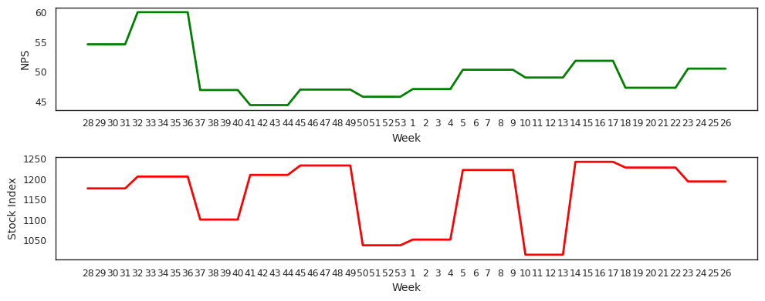
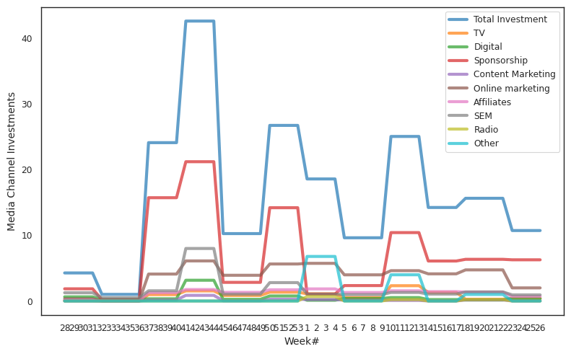
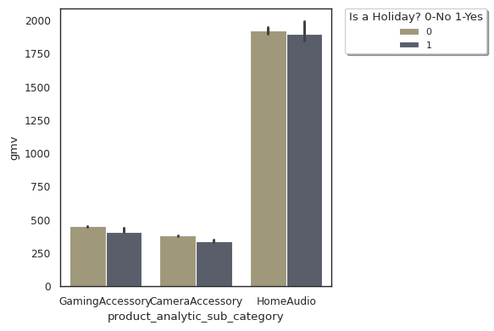
EXPLORATORY DATA ANALYSIS
Displaying trend of NPS and Stock Index by week
Displaying trend of various Media Channel Investments by week
Understanding: The product's NPS rating was at its maximum from weeks 32 to 35, which is also when peak discounts are offered.
Average Revenue from Holiday/Non-holiday days for product subcategories:
Insight : The average revenue from holiday and non-holiday days for 3 brand sub-categories is more or less equivalent.
Insight: Throughout the past year, sponsorships received the majority of the advertising dollars, followed by online marketing and search engine marketing.

Slide 17
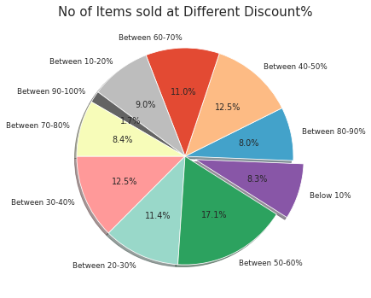
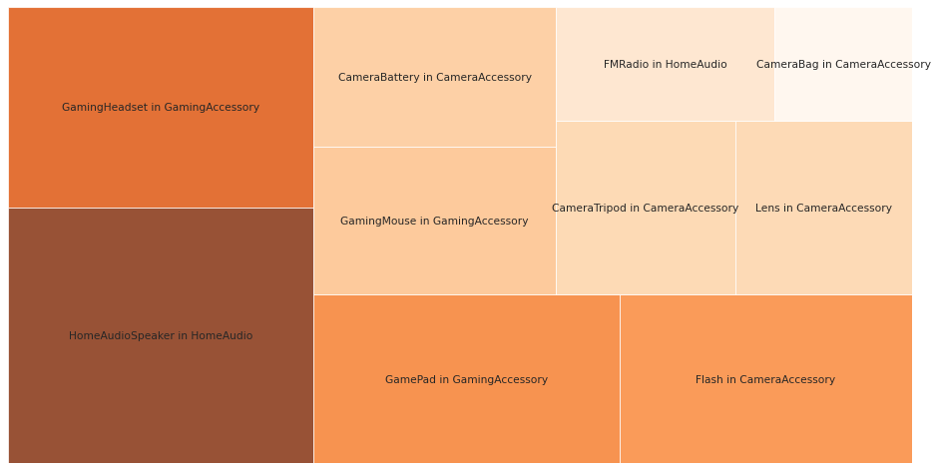
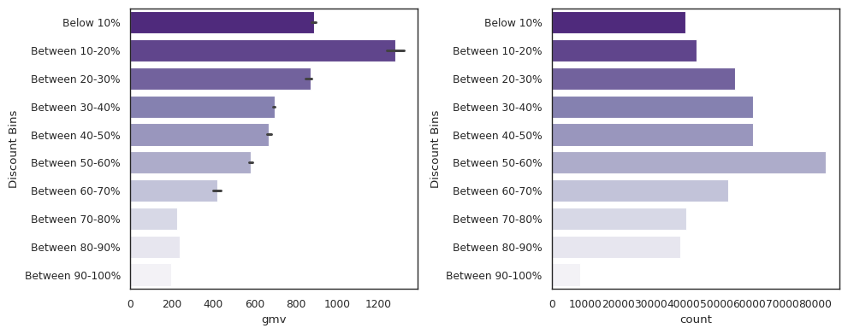
EXPLORATORY DATA ANALYSIS
Percentage of items sold at different Discount% segments
Tree map for Revenue
Plots for Discount Vs gmv/count
It demonstrates that, despite excellent profits, revenue declines at a bigger discount, which results in a loss for the organization. The company's most profitable discount range is between 10 and 20 percent.
Most of the sales are from Home Audio Speakers followed by gaming headset & gamepad
Finding: Maximum product sold with a discount of 50% and 60%

Slide 18
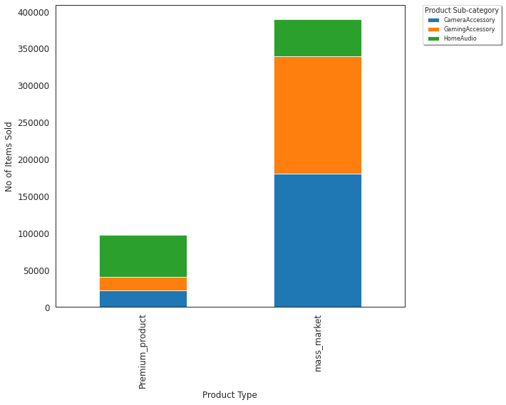
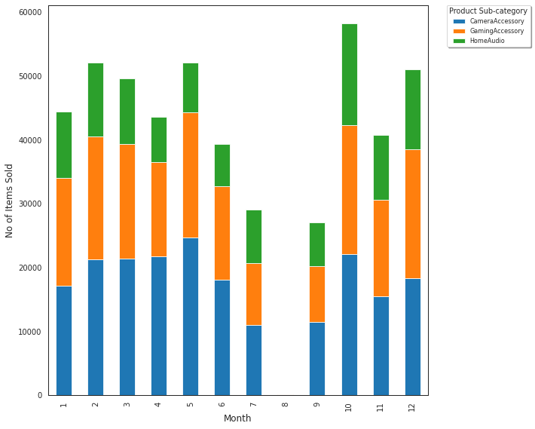
EXPLORATORY DATA ANALYSIS
Items(Premium product/Mass-market) sold per product subcategories
Plots for Discount Vs gmv/count
Insights : Home audio devices were some of the best-selling items in Premium product, with the majority of units sold falling into the mass market category, with camera and gaming accessories selling best there.
Insights : Months 5, 10 has more sales

Slide 19
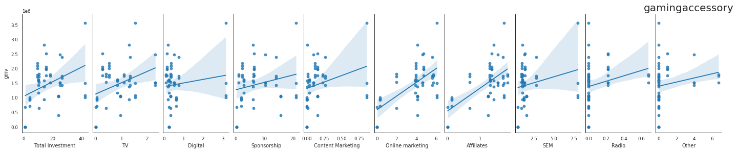
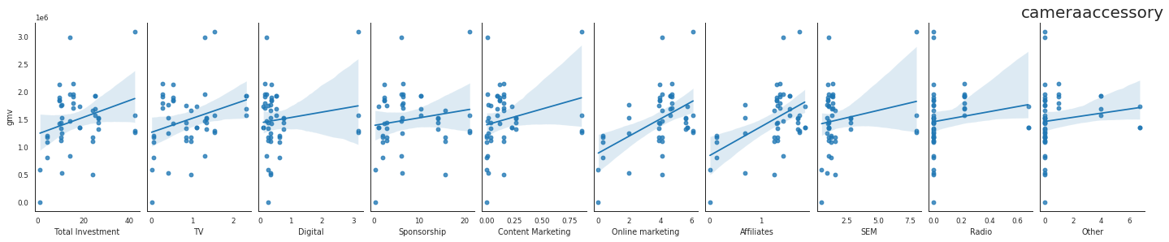
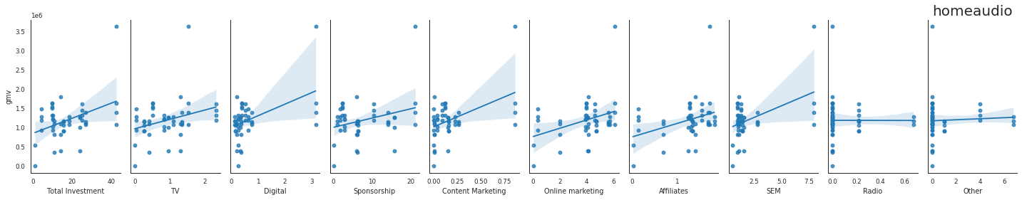
EXPLORATORY DATA ANALYSIS
RELATIONSHIP BETWEEN REVENUE AND ADVERTISEMENT SPENDS

Slide 20
Model Evaluation- CAMERA ACCESSORY
model | Top KPI | R SQUARE | ADJ R SQAURE | MSE
SIMPLE LINEAR MODEL | Is_mass_market,product_vertical_Strap, product_vertical_CameraBattery, product_vertical_CameraTripod,Other,Sponsorship, Max Temp, product_vertical_Prepaid,Other | 0.960 | 0.947 | 0.00377
KOYCK MODEL | Product_vertical_CameraBattery, Product_vertical_Telescope, Product_vertical_CameraMicrophone, Product_vertical_Softbox, Product_vertical_CameraTripod, Online marketing | 0.859 | 0.827 | 0.01071
MULTIPLICATIVE MODEL | Product_vertical_lens, Discount %,Affiliates_SMA_5 | 0.944 | 0.932 | 0.00646
DISTRIBUTED LAG ADDITIVE | Product_vertical_flash, Product_vertical_strap, Product_vertical_ExtensionTube_lag2, Product_vertical_ ExtensionTube_lag1, Product_vertical_CameraBatteryGrip,special_sales_lag3, Max Temp_lag1,NPS_SMA_3_lag3 | 0.944 | 0.926 | 0.00286
DISTRIBUTED LAG MULTIPLICATIVE | Discount %, Online marketing | 0.887 | 0.880 | 0.0140

Slide 21
Key Outcome - CAMERA ACCESSORY
Simple Linear Model is selected as the best model based on the highest Adjusted R- square and low MSE values. Also, contains the features that the company can act upon.
From the graph, we can see that, the sales of CameraBag, CameraBattery, CameraTripod by order payment type Prepaid through Online marketing have positive impact on the GMV value.
Budget shall be focussed on increasing spent on online marketing and discount.

Slide 22
Model Evaluation- HOME AUDIO
model | Top KPI | R SQUARE | ADJ R SQAURE | MSE
SIMPLE LINEAR MODEL | Product_vertical_VoiceRecorder , Radio_EMA_8,TV_SMA_5,Content Marketing_SMA_5,sponsorship, product_vertical_HomeAudiospeaker | 0.956 | 0.944 | 0.00487
KOYCK MODEL | Product_vertical_FM Radio, Product_vertical_HomeAudioSpeaker, Product_vertical_VoiceRecorder, Digital | 0.978 | 0.975 | 0.00111
MULTIPLICATIVE MODEL | Product_mrp, Product_vertical_ HomeAudiospeaker, sla | 0.993 | 0.992 | 0.00253
DISTRIBUTED LAG ADDITIVE | Product_vertical_ HomeAudiospeaker, Product_vertical_FM Radio, Product_vertical_VoiceRecorder, order_payment_type_prepaid,Affiliates_SMA_5_lag3, Snow on Grnd (cm)_lag2, product_mrp_lag3 | 0.987 | 0.983 | 0.00106
DISTRIBUTED LAG MULTIPLICATIVE | order_payment_type_prepaid, Product_vertical_ HomeAudiospeaker,Radio_lag3 | 0.994 | 0.993 | 0.00207

Slide 23
Key Outcome - HOME AUDIO
Distributed Lag Model(Additive) is selected as the best model based highest R- square and low MSE values so that the company has one less feature to o focus upon & grow almost equivalently.
From the graph, we can see that the sales for HomeAudioSpeaker and FMRadio has positive impact on the GMV value.
Budget shall be focused on increasing spent on TV Advertisement and Sponsorship.

Slide 24
Model Evaluation- GAMING ACCESSORY
model | Top KPI | R SQUARE | ADJ R SQAURE | MSE
SIMPLE LINEAR MODEL | Special_sales,product_vertical_GamingKeyboard, product_vertical_GameControlMount, Affiliates_SMA_5,Content Marketing_SMA_5, | 0.773 | 0.734 | 0.01670
KOYCK MODEL | TV_SMA_5,Content Marketing_SMA_5,product_mrp,special_sales, Other_SMA_3, Total Snow(cm), product_vertical_GameControlMount | 0.706 | 0.630 | 0.02252
MULTIPLICATIVE MODEL | Online marketing_SMA_3, product_mrp, product_vertical_TVOutCableAccessory | 0.958 | 0.954 | 0.00248
DISTRIBUTED LAG ADDITIVE | Is_mass_market, product_vertical_GamingAccessoryKit, product_vertical_JoystickGamingWheel, product_vertical_GamingHeadset_lag3, order_payment_type_Prepaid | 0.991 | 0.989 | 0.00063
DISTRIBUTED LAG MULTIPLICATIVE | product_vertical_TVOutCableAccessory, product_vertical_ TVOutCableAccessory_lag1, product_procurement_sla_lag1 | 0.942 | 0.937 | 0.00473

Slide 25
Key Outcome - GAMING ACCESSORY
DISTRIBUTED LAG ADDITIVE Model is selected as the best model based on high R-square and low MSE values& the features which the company can act upon.
From the graph, we can see that the sale of GamingAccessoryKit and by order payment type Prepaid in mass market , has positive impact on the GMV value
Budget shall be focused on increasing spent on Online Marketing and Sponsorship.

Slide 26
Thank you
Submitted By:
Aravind Girish
Divya Saurabh
Thera Bhuvana Chandra

